Slide 1

Employee Data Analysis using Excel
STUDENT NAME: S. SOUNDARAPANDI
REGISTER NO: 2213111036155
DEPARTMENT: B.COM(GENRAL)
COLLEGE: GOVERNMENT ARTS COLLEAGE NANDANAM
NM ID : asunm13112022batch2230115
1
Notes:
1

Slide 2

PROJECT TITLE
Employee Performance Analysis using Excel
2

Slide 3



AGENDA
Problem Statement
Project Overview
End Users
Our Solution and Proposition
Dataset Description
Modelling Approach
Results and Discussion
Conclusion
3/21/2024 Annual Review
3

Slide 4

PROBLEM STATEMENT
The aim of this project is to address the problem that is difficult to evaluate employee performance and to know the sum of salaries of the employees in department wise
4

Slide 5

PROJECT OVERVIEW
.
In this project I have analysed the salary of the employees in the basis of gender and the department wise and also analysed about the employee type in the company
5

Slide 6

WHO ARE THE END USERS?
1.Management of the company
2.Statistical department
3.Financial departmenmts
6

Slide 7

OUR SOLUTION AND ITS VALUE PROPOSITION
I have used various techniques in excel like
Conditional formulating : to finding null values
Pivot table : to make the data in presentable and neat maner
Alignment to centre the data so that it will look nice
7

Slide 8
Dataset Description
In this I have used the data which I have collected from kaggle.com
The data which are all used in my project are as follows;
Employee id : alpha numeric
Name : alphabets
Gender : alphabets
Salary : numeric
Employee type :alphabets
Work location :alphabets
Notes:
8

Slide 9

THE "WOW" IN OUR SOLUTION
In this project I have used picot chart and slicers in the separate excel sheet so it makes very easy to understand for the users who are going to use it
3/21/2024 Annual Review
9

Slide 10
MODELLING
Collection of data from kaggle.com
Selection of data
Selection of analysis (salary, department and employee type)
Uses of various techniques in the excel (pivot table , slicers , pie chart etc)
Clearing unwanted datas
Using graph charts
Finding result
10

Slide 11
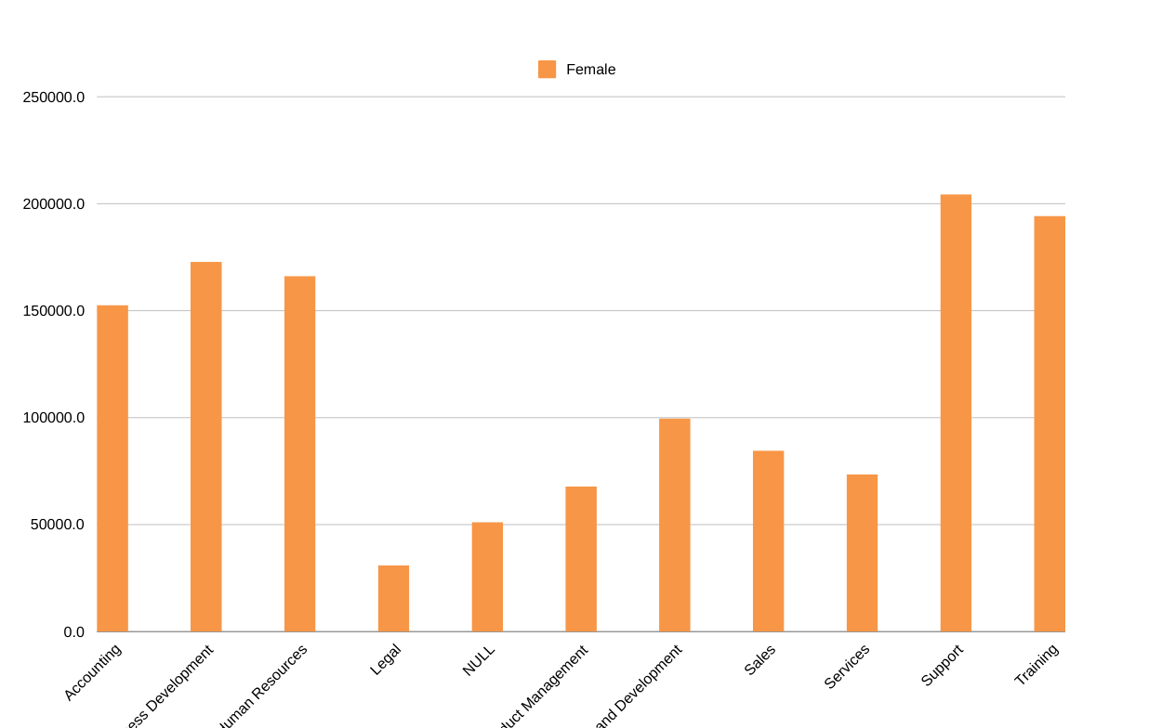
RESULTS
Sum of salaries of the female employees in all department
11

Slide 12
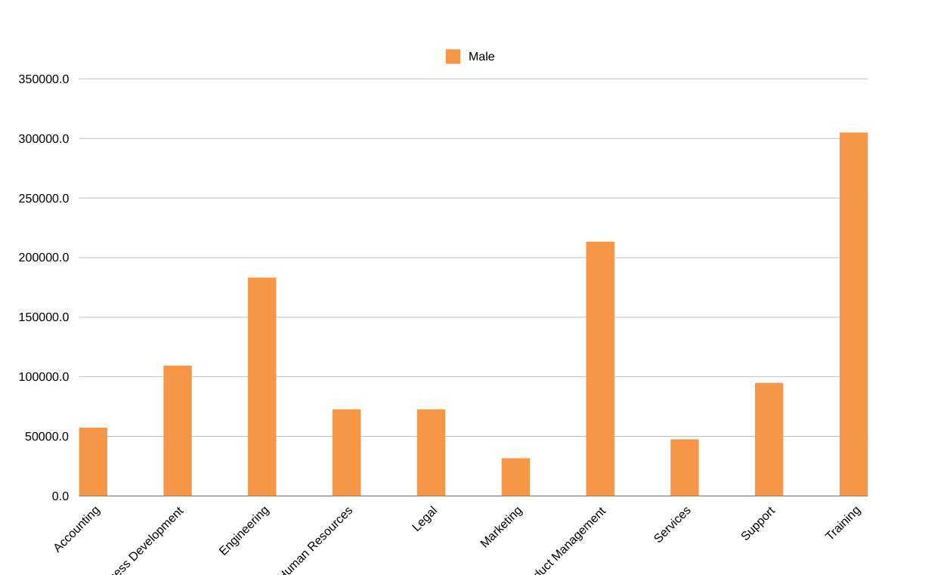
Result
Sum of salaries of the male employees in all departments

Slide 13
conclusion
It was a wonderful learning experience for me while preparing on this project. This project has developed my thinking skills related to this project. Here I have come to the end of this project , in this project I have a taken a data from kaggle.com and analysed it and prepared a pivot table and slicers in a excel sheet about the salaries in the basis of gender and various department in the company. So it is very easy to understand about the salary basis ..

